Slide 1
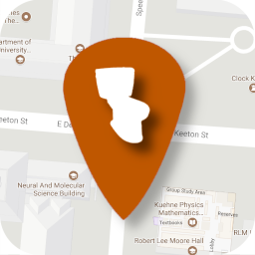
UT Bathroom Services (UTBS)
David Chun, Zoe Ng, Joel Wang, Hans Xu

Slide 2
Project Overview
An Android app that allows users to locate bathroom and water facilities on campus
Locations are ranked by geographical proximity, cleanliness, user reviews, and other criteria
User based reviews form a central database and are factored into recommendations

Slide 3
Benefits of UTBS
Easily locate bathrooms and water fountains on the map
Search for bathrooms and water fountains based on desired factors, such as WiFi quality or water temperature
Save a list of favorite bathrooms and water fountains to quickly find them later

Slide 4
Notable Technologies Used
Firebase Cloud Firestore
DBFlow SQL Database
Google Play Services Integration

Slide 5
Demo

Slide 6
Questions

